Slide 1
Acceptance testing with web automation
45426: Teste e Qualidade de Software
Ilídio Oliveira
v2025-10-15

Slide 2
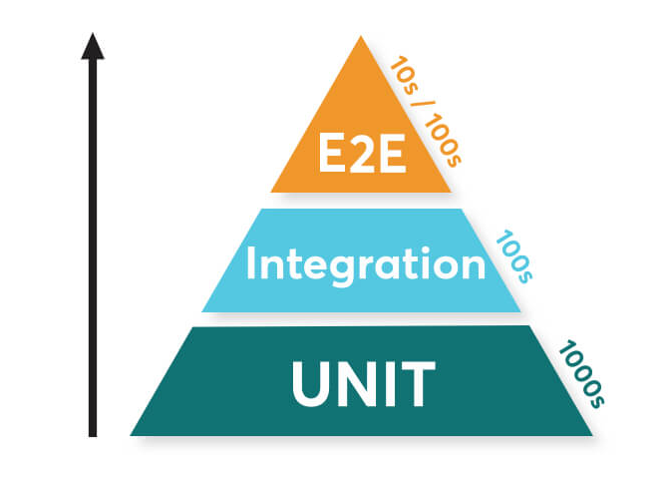
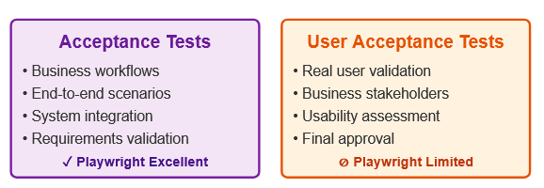

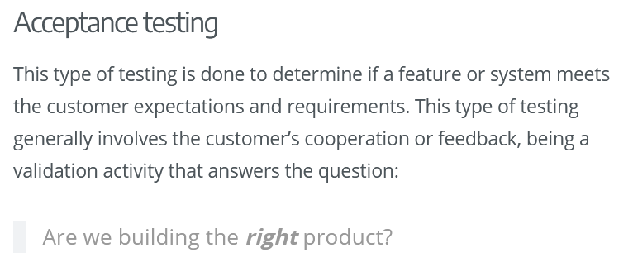


Automated Acceptance testing (≠ UAT)

Slide 3

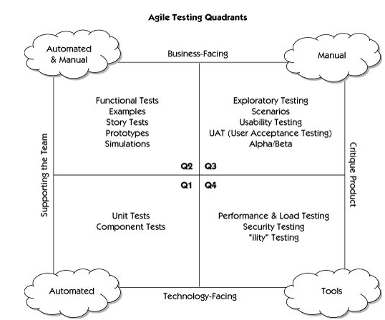

Agile testing quadrants
acceptance

Slide 4
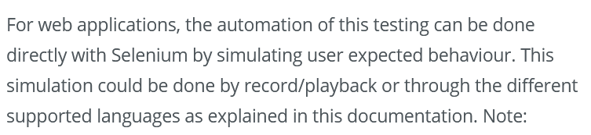
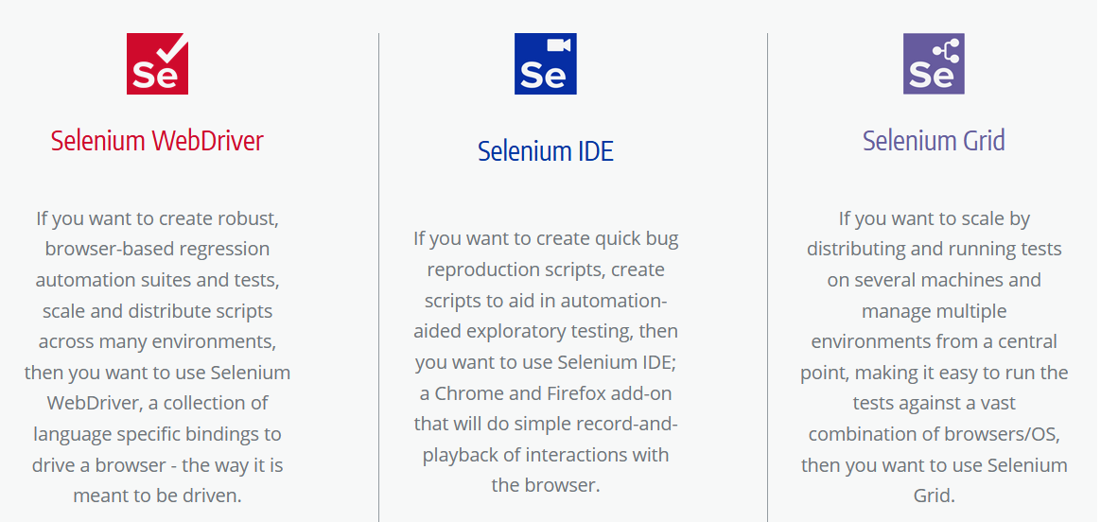

Web UAT ⊂ UAT ⊂ Functional testing
…by controlling the browser programmatically.

Slide 5
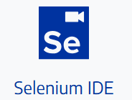
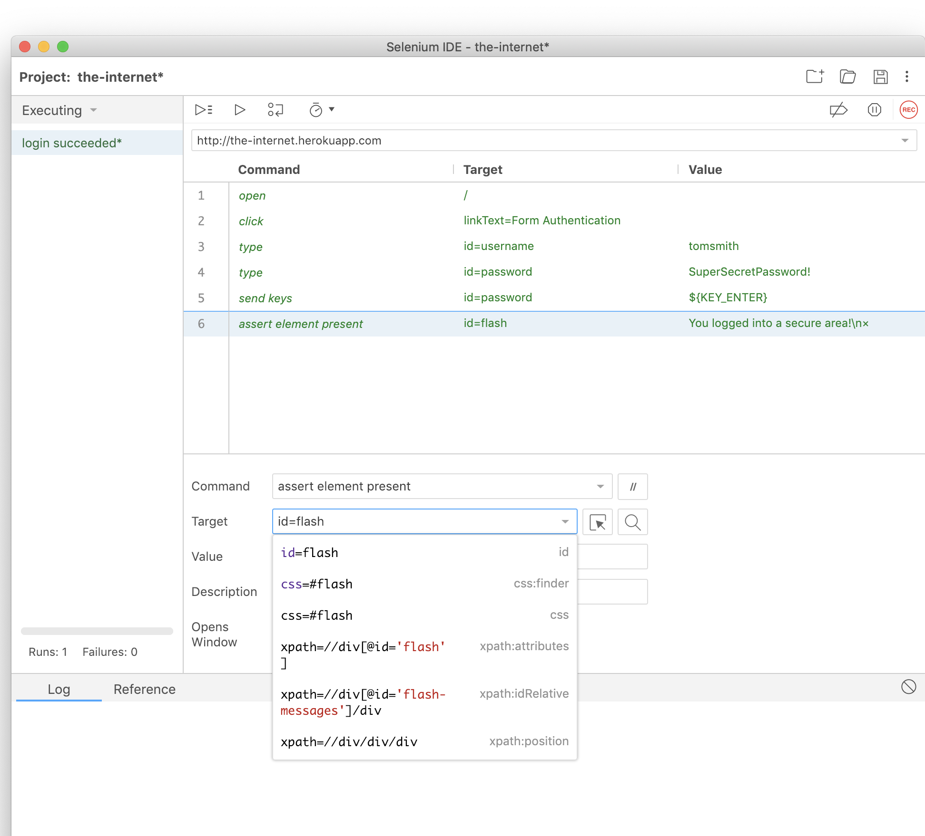
Selenium IDE
Browser plugin
Record/replay tests
Developer-friendly:
    Interactive web elements picker
    Step-by-step execution (debug)
    Can export the test as code
    These tests can be run in different cloud services
  …
Similar alternative:
  https://www.katalon.com/katalon-recorder-ide/
https://www.selenium.dev/selenium-ide/

Slide 6
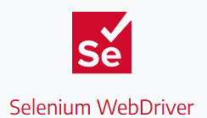
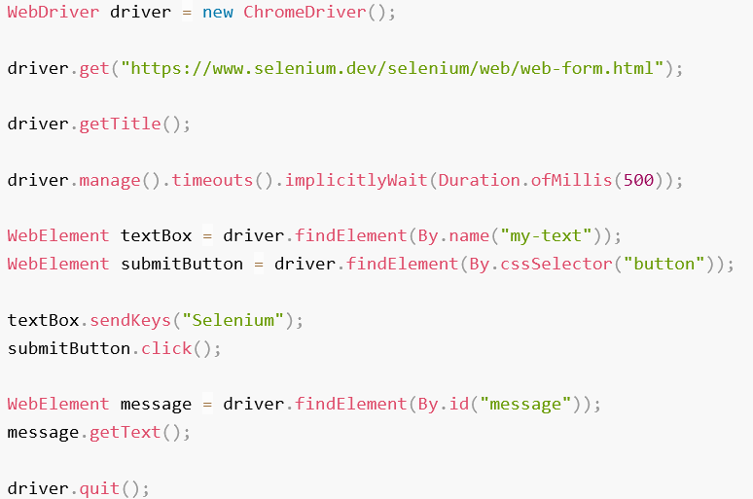
Basic script
“session” context
Actions automation
Implicit timeouts config (if needed)
Locators to retrieve references to page elements

Slide 7
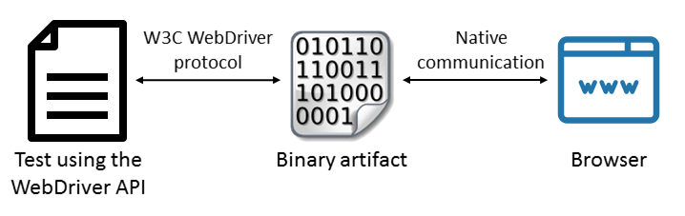
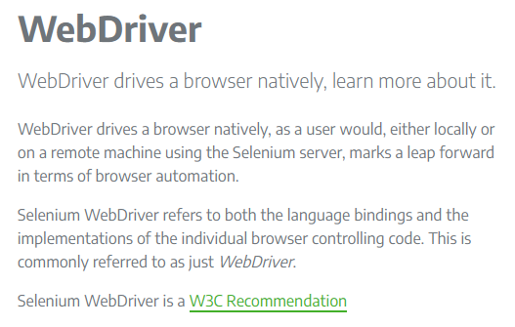
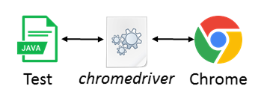
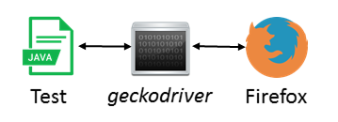

Selenium WebDriver for testing

Slide 8
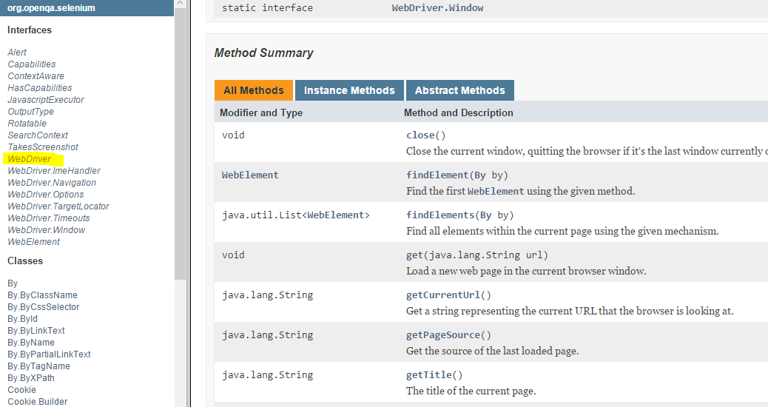
https://seleniumhq.github.io/selenium/docs/api/java/org/openqa/selenium/WebDriver.html

Slide 9
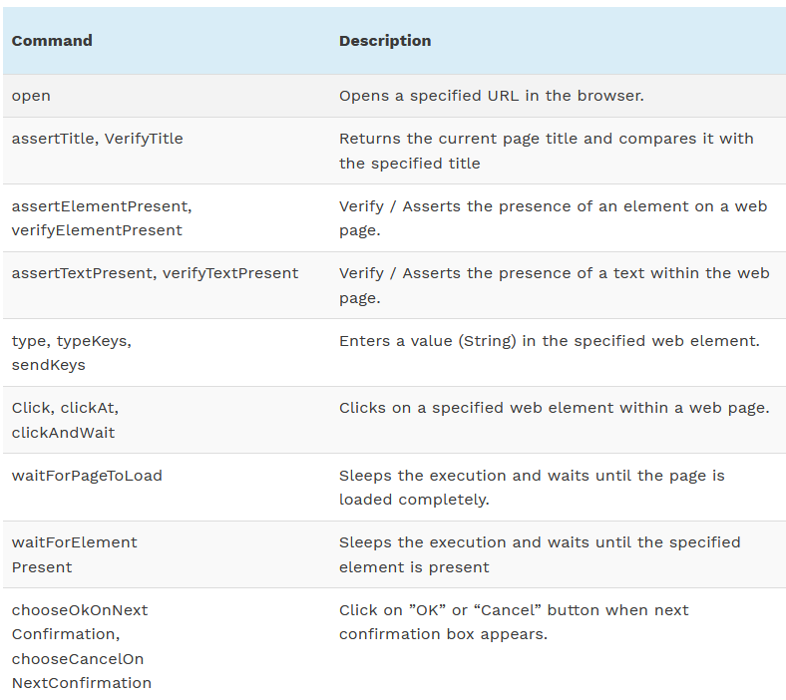
Frequent commands
Step-by-step introduction with examples available from:
https://www.softwaretestinghelp.com/selenium-ide-script-selenium-tutorial-3/

Slide 10
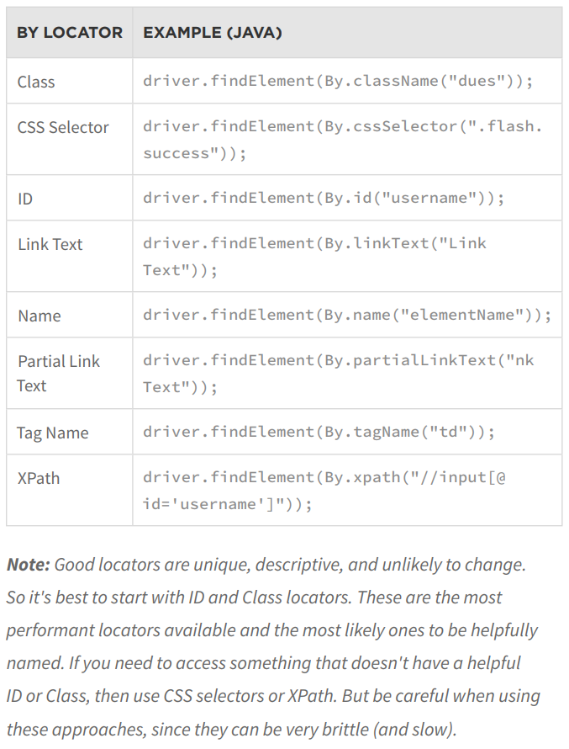
Locating elements in the page
https://www.selenium.dev/documentation/webdriver/elements/locators/

Slide 11
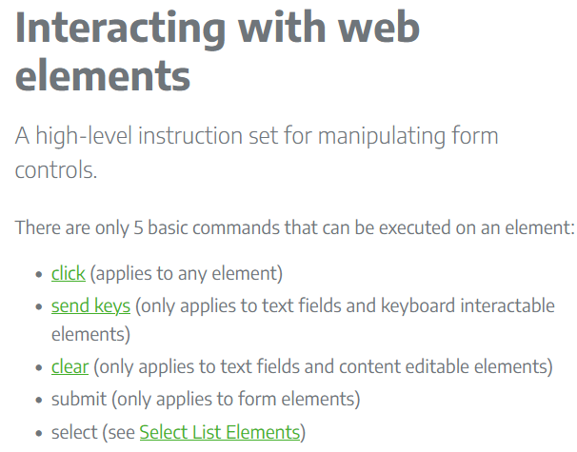
Acting in the page

Slide 12
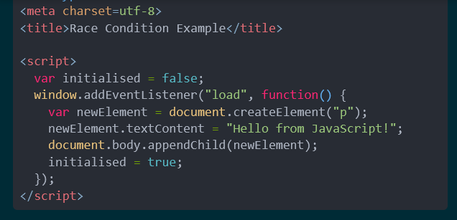
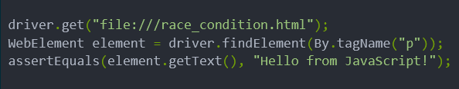
Race conditions in tests
Might cause intermittent results…
https://www.selenium.dev/documentation/en/webdriver/waits/

Slide 13
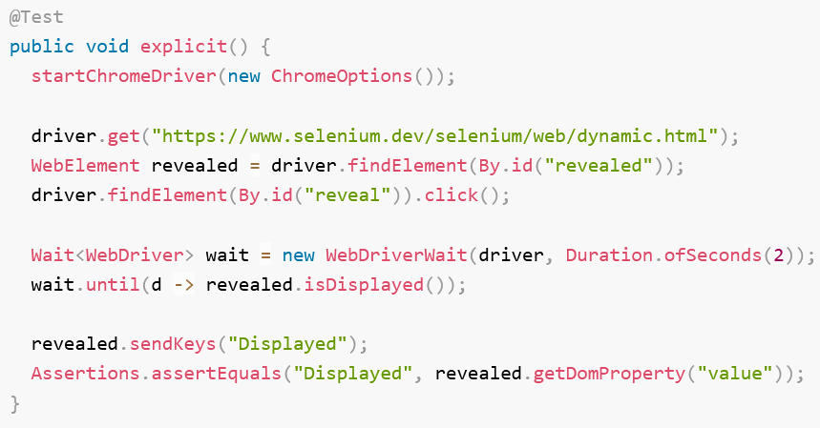

Explicit waits
  A common challenge for browser automation is ensuring that the web application is in a state to execute a particular Selenium command
  The processes often end up in a race condition where sometimes the browser gets into the right state first (things work as intended) and sometimes the Selenium code executes first (things do not work as intended). This is one of the primary causes of flaky tests.
  Ensure state with
  explicit waits.
https://www.selenium.dev/documentation/webdriver/waits/

Slide 14
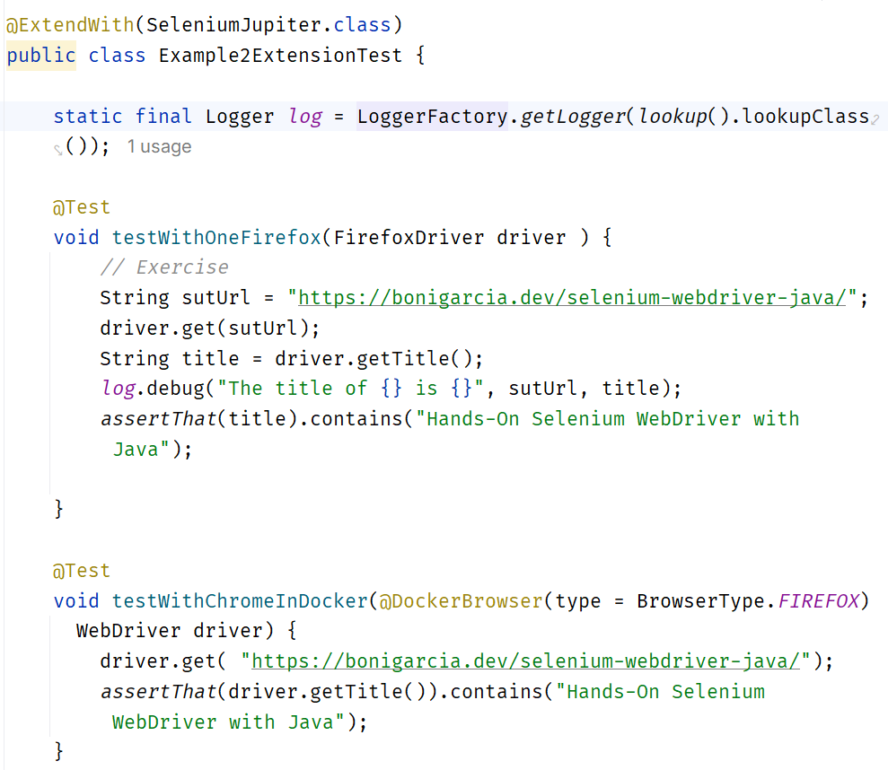
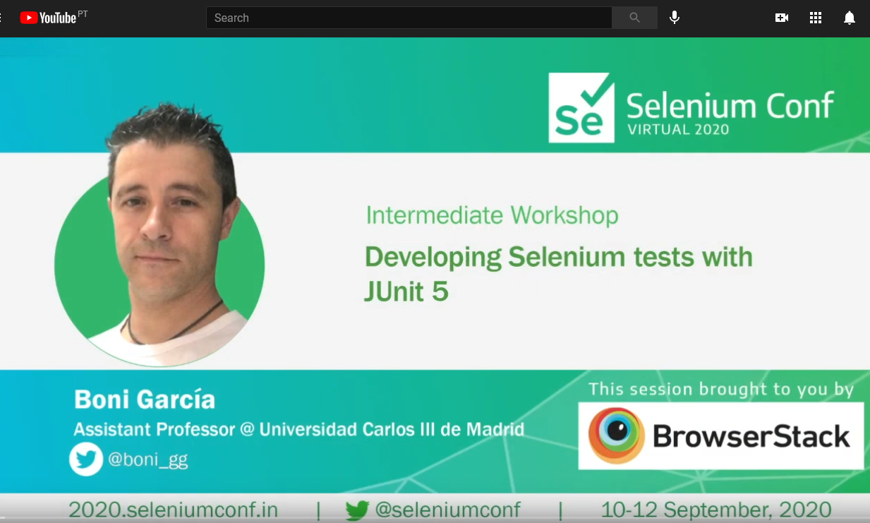
Selenium-Jupiter (JUnit 5 extension)
  Get browser (driver) instance with DI (at constructor or parameter levels)
  Automatic connect/close browser
  Can retrieve browser driver automatically
  Auto-deploy containers and run tests “remotely“ (RemoteWebDriver mode)
https://bonigarcia.github.io/selenium-jupiter/

Slide 15
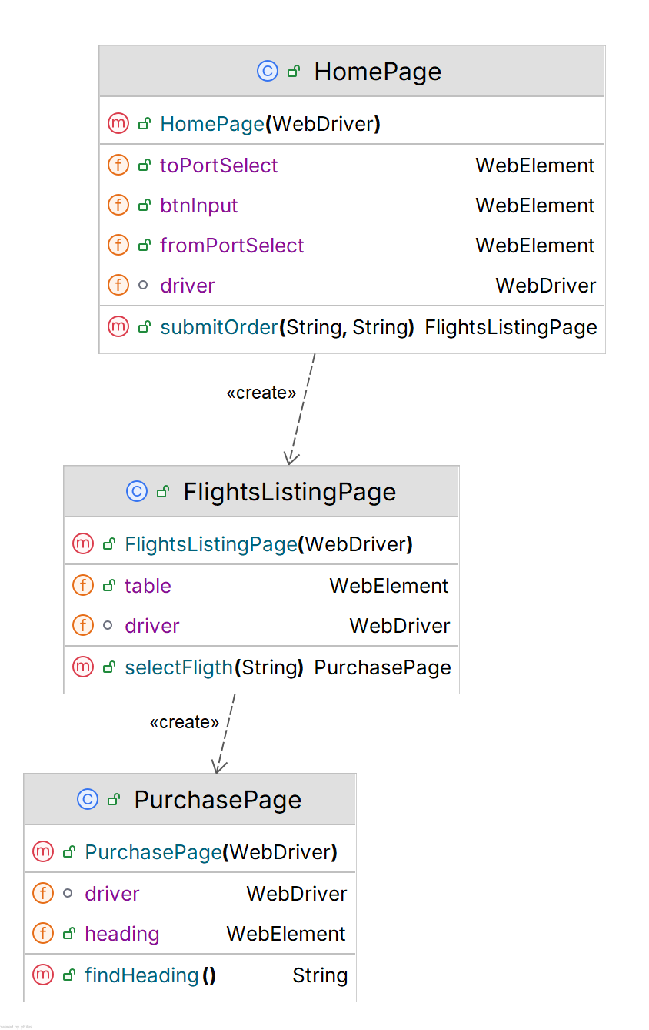
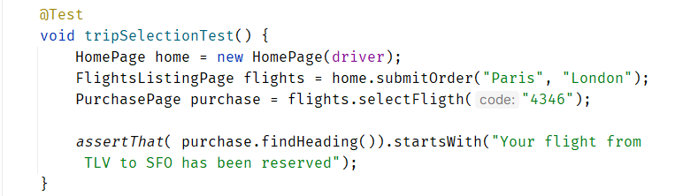



Page Object Model
  Create Classes to map the Pages
  Encapsulate WebDriver low-level interaction inside the target class method

Slide 16

Playwright
Core features
Open-source automation framework
Significant evolution in web automation tooling, designed specifically for modern web applications.
Cross-Browser: unified API; unlike Selenium that requires separate drivers, Playwright bundles browser binaries and communicates directly with them.
Auto-Waiting Mechanism: a significant innovation is the built-in auto-waiting. Before performing actions, Playwright automatically waits for elements to be actionable
Multi-Context architecture: uses isolated browser contexts (cookies, localStorage, and session data,…), within a single browser instance.
↑ parallel test execution.
↑ performance.
https://playwright.dev/

Slide 17
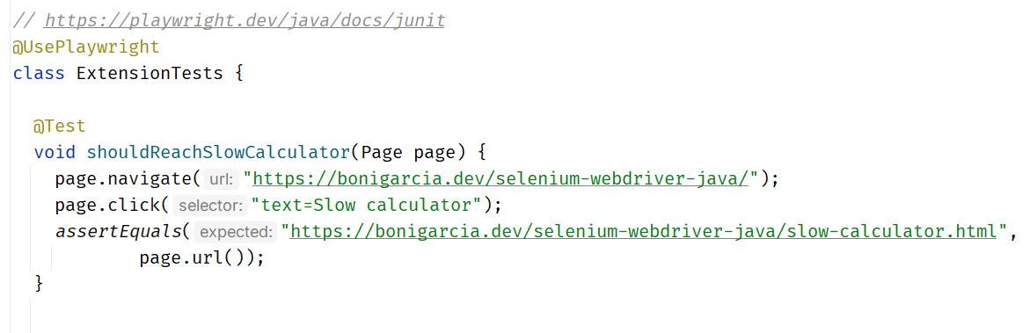

Playwright extension & fixtures (experimental)
Note the test runs, but no browser will be shown…
(headless mode)

Slide 18
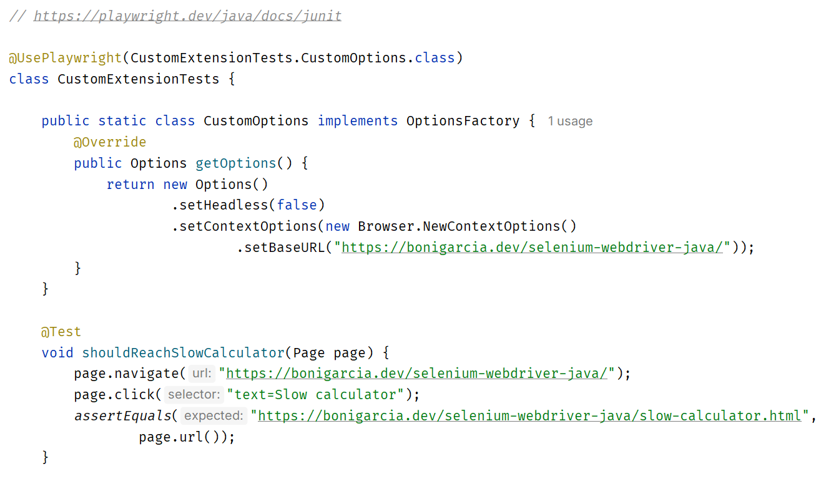
Fixture and options

Slide 19
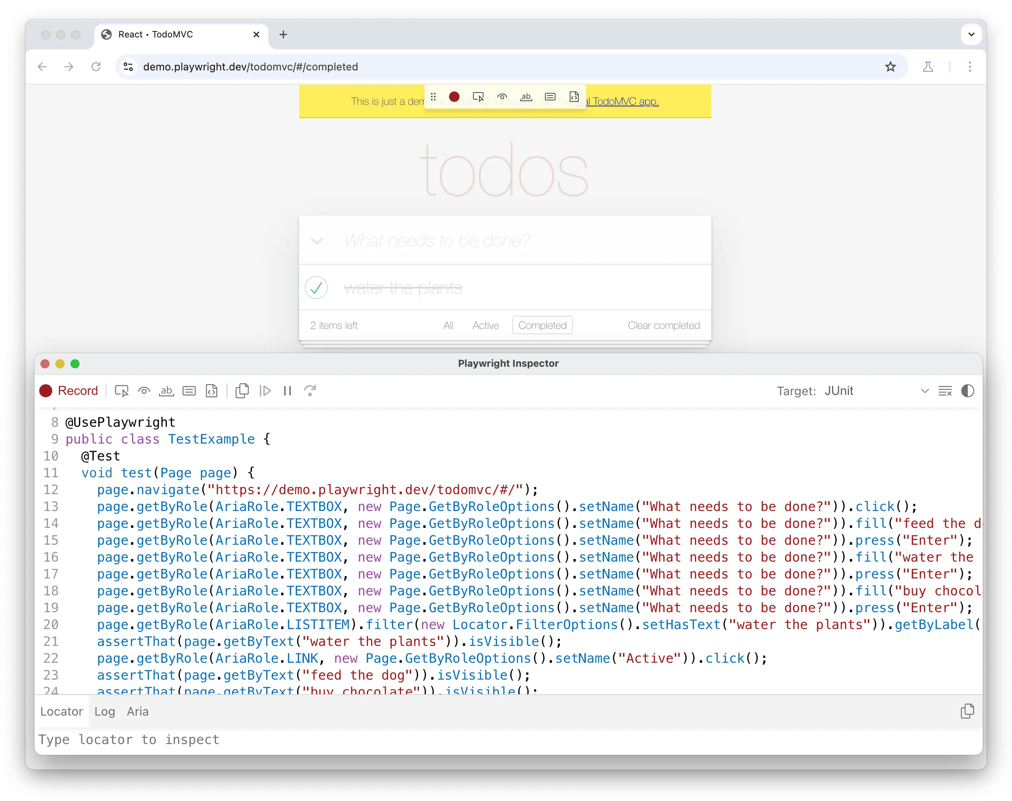
It’s a kind of magic…
mvn exec:java -e -D exec.mainClass=com.microsoft.playwright.CLI -D exec.args="codegen demo.playwright.dev/todomvc"

Slide 20
“Other” uses
Are web automation frameworks just for tests?

Slide 21
Suggested links
Very comprehensive tutorials
Selenium doc: https://www.selenium.dev/
Selenium-Jupiter doc: https://bonigarcia.github.io/selenium-jupiter/

